Slide 1


“Development Of Line Following Robot”
Project Synopsis Presentation
Varsha. V Sneka. P Sanjay. S Project guide: Dr. MANGALA GOWRI
Associate Professor, Dept of ECE, Atria IT,
Bangalore
Department of Electronics & communication Engineering,
Atria Institute of Technology, Bangalore

Slide 2
Presentation Overview
Introduction
Literature survey
Problem statement
Project overview with Block diagram
Expected Outcomes
Applications
References.

Slide 3
Introduction
Line following robots are designed to follow lines on surfaces using infrared sensors.
They use an IR transmitter and receiver to detect reflected light from white surfaces and absorbance on black surfaces or remote control.
These robots can be controlled using voice commands through an Android device.
The demonstration of line following robot can be represented as smart dustbin dut.
The design, assembly, and simulation of these robots are done using Arduino software.

Slide 4
Literature survey
Authors | Title, Contributions and Observations
Saharsh Oswal1 and Saravanakumar ,School of Mechanical Engineering, Vellore Institute of Technology, India 2021. | “Line following robots on factory floors”, Significance and Simulation study using Coppelia Sim. Studying and working on LFR.
Alfian Maarif, Aninditya Anggari Nuryono, Iswanto, FORTEI, IEEE 2020. | “Vision-Based Line Following Robot In Webots”, The line following robot aims to detect image based lines and to navigate the robot to follow the path.
Jagruti Chaudhari, Asmita Desai, S. Gavarskar, ICCT,IEEE 2019. | “Line Following Robot Using Arduino for Hospital”, The LFP using Arduino for transportation inside the health care institution.

Slide 5
Problem Statement
Before the invention of line following robots, there were several challenges and limitations in various fields that required automated systems.
Manual Labour.
Lack of Precision
Limited Flexibility
Safety Risk
These robots helped improve efficiency, reduce costs, enhance safety, and open up new possibilities for automation and research in various industries and fields.

Slide 6
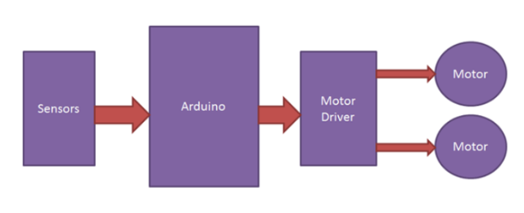
Block Diagram
Fig1:line following robot and dut

Slide 7
Expected Outcomes
The overview outcomes from the line following robot and dut are:
Accurate Line Tracking
Efficient and Smooth Movement
Real-Time Decision Making
Robust Sensor Integration
User-Friendly Control
Energy Efficiency.

Slide 8
Applications
Some of the major fields in which the line following robot and dut are:
Industrial Automation
Food and Beverage Industry
Medical Facilities
Cleanliness and Maintenance
Education and Research
Waste Management Optimization
Smart City Initiatives.

Slide 9
References
“Line following robots on factory floors”, Significance and Simulation study using Coppelia Sim. Saharsh Oswal1 and Saravanakumar ,School of Mechanical Engineering, Vellore Institute of Technology, India 2021.
“Vision-Based Line Following Robot In Webots” Alfian Maarif, Aninditya Anggari Nuryono, Iswanto, FORTEI, IEEE 2020.
“Line Following Robot Using Arduino for Hospital”, Jagruti Chaudhari, Asmita Desai, S. Gavarskar, ICCT,IEEE 2019.

Slide 10
Thank You

